Slide 1
Artificial Intelligence
Engr. Faiz ul haque Zeya
Department of software engineering
BUKC.

Slide 2
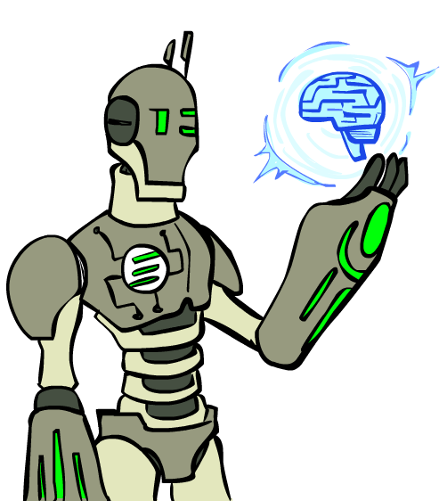
Today
What is artificial intelligence?
What can AI do?
State of art AI
History of AI
Agent and Environment.
Generative AI

Slide 3
Artificial intelligence (AI) is the theory and development of computer systems capable of performing tasks that historically required human intelligence, such as recognizing speech, making decisions, and identifying patterns.
AI is an umbrella term that encompasses a wide variety of technologies, including machine learning, deep learning, and natural language processing (NLP).

Slide 4
Rational Decisions
We’ll use the term rational in a very specific, technical way:
Rational: maximally achieving pre-defined goals
Rationality only concerns what decisions are made
(not the thought process behind them)
Goals are expressed in terms of the utility of outcomes
Being rational means maximizing your expected utility
A better title for this course would be:
Computational Rationality
Notes:
Not about building machines that don’t get angry
Example of utilities. 10 for A, 1 for each Friday with friends
People being rational.

Slide 5
At the simplest level, machine learning uses algorithms trained on data sets to create machine learning models that allow computer systems to perform tasks like making song recommendations, identifying the fastest way to travel to a destination, or translating text from one language to another. Some of the most common examples of AI in use today include:
ChatGPT: Uses large language models (LLMs) to generate text in response to questions or comments posed to it.
Google Translate: Uses deep learning algorithms to translate text from one language to another.
Netflix: Uses machine learning algorithms to create personalized recommendation engines for users based on their previous viewing history.
Tesla: Uses computer vision to power self-driving features on their cars.

Slide 6
Artificial general intelligence (AGI) refers to a theoretical state in which computer systems will be able to achieve or exceed human intelligence. In other words, AGI is “true” artificial intelligence as depicted in countless science fiction novels, television shows, movies, and comics.

Slide 7
According to Professor Arend Hintze of the University of Michigan
1. Reactive machines
Reactive machines are the most basic type of artificial intelligence. Machines built in this way don’t possess any knowledge of previous events but instead only “react” to what is before them in a given moment. As a result, they can only perform certain advanced tasks within a very narrow scope, such as playing chess, and are incapable of performing tasks outside of their limited context.

Slide 8
2. Limited memory machines
Machines with limited memory possess a limited understanding of past events. They can interact more with the world around them than reactive machines can. For example, self-driving cars use a form of limited memory to make turns, observe approaching vehicles, and adjust their speed. However, machines with only limited memory cannot form a complete understanding of the world because their recall of past events is limited and only used in a narrow band of time.

Slide 9
3. Theory of mind machines
Machines that possess a “theory of mind” represent an early form of artificial general intelligence. In addition to being able to create representations of the world, machines of this type would also have an understanding of other entities that exist within the world. As of this moment, this reality has still not materialized.

Slide 10
4. Self-aware machines
Machines with self-awareness are the theoretically most advanced type of AI and would possess an understanding of the world, others, and itself. This is what most people mean when they talk about achieving AGI. Currently, this is a far-off reality.

Slide 11
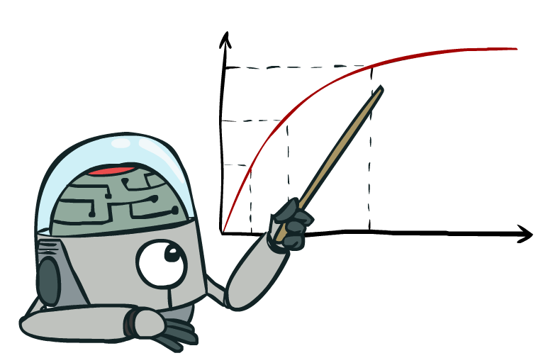
Maximize Your
Expected Utility
Notes:
Distill course to maximize expected utility.
Make these 4 better

Slide 12
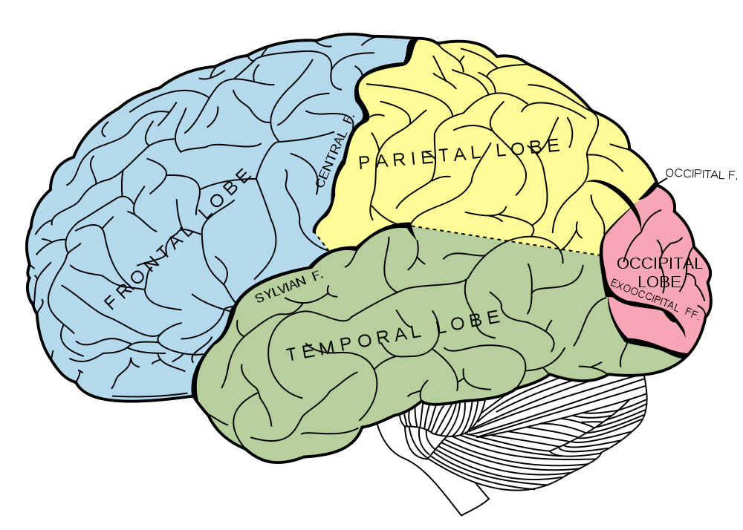
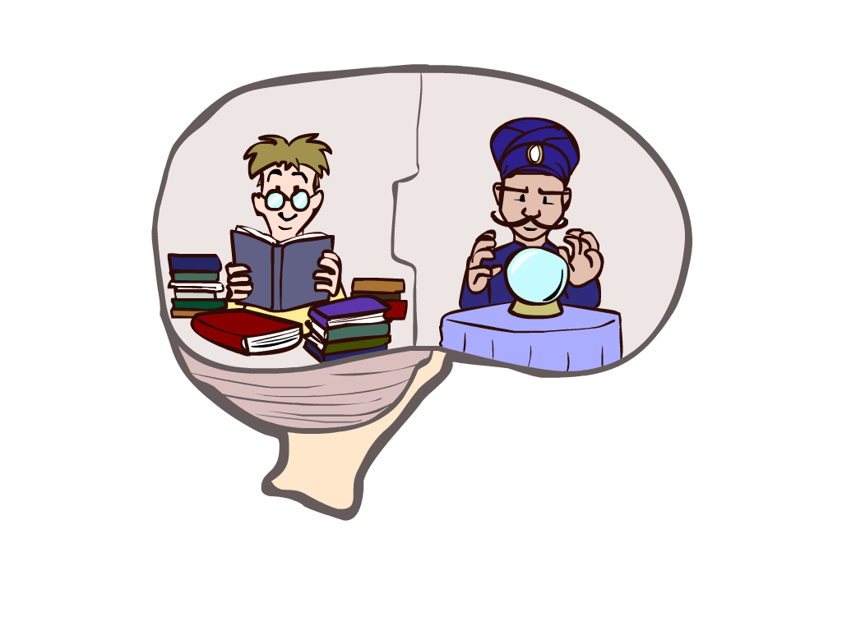
What About the Brain?
Brains (human minds) are very good at making rational decisions, but not perfect
Brains aren’t as modular as software, so hard to reverse engineer!
“Brains are to intelligence as wings are to flight”
Lessons learned from the brain: memory and simulation are key to decision making
Notes:
Brains are the existence proof that AI can be made, much like birds were the existence proof to flight.
But they are hard!
Lessons:
Memory – do not forget valuable info
Simulation – extrapolating from past info, generalize, transfer, infer, many words that will later be central to the course
Stopped making wings that flap

Slide 13
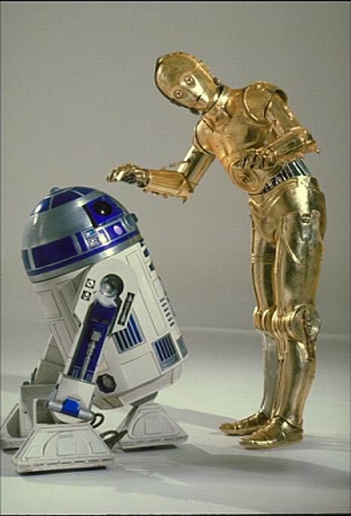
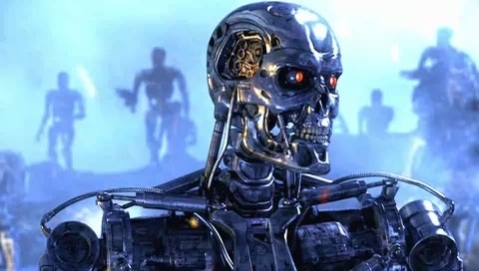
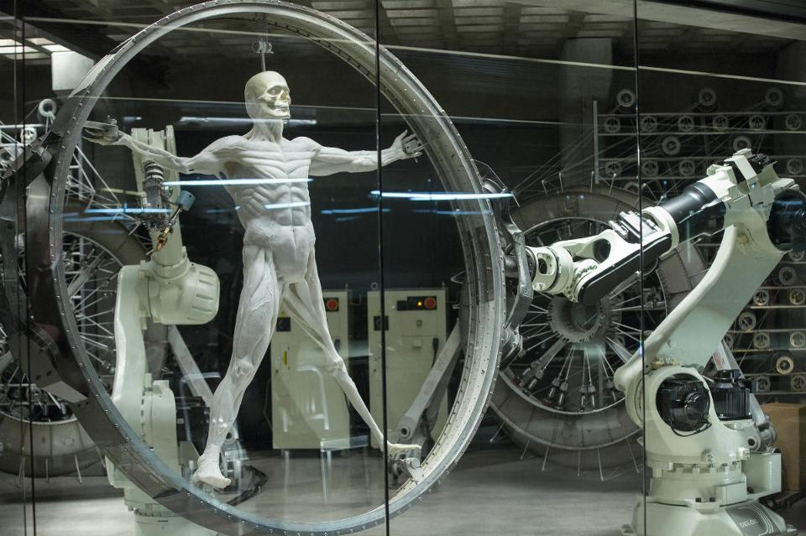

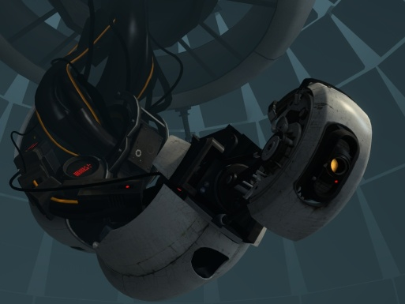
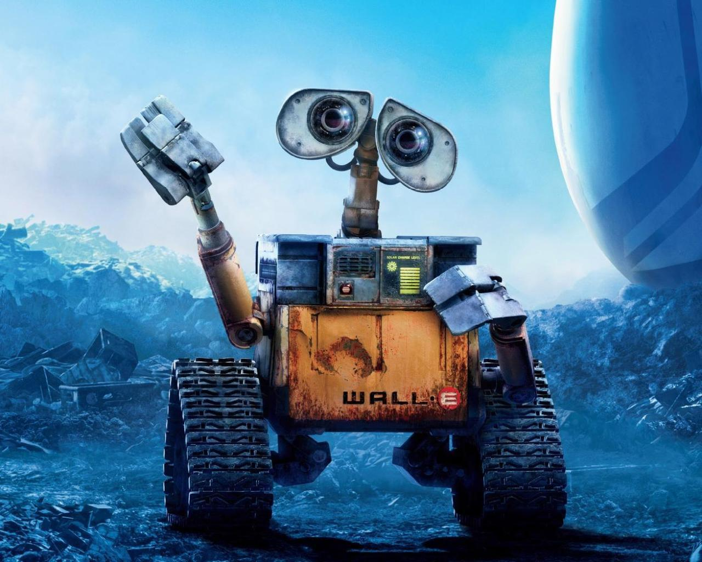
Sci-Fi AI?

Slide 14
Notes:
Robots look like this. We have autonomous cars that figure out how to take us to our destination

Slide 15
Notes:
Or drones that record cool videos of us as we do outdoor activities
So what is powering all of this? That’s what this course is for.

Slide 16

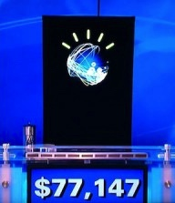
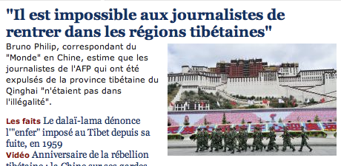

Natural Language
Speech technologies (e.g. Siri)
Automatic speech recognition (ASR)
Text-to-speech synthesis (TTS)
Dialog systems
Language processing technologies
Question answering
Machine translation
Web search
Text classification, spam filtering, etc…
https://play.aidungeon.io/
Notes:
Deepfake
chatbot examples
Do you know about IBM watson, Ken Jennings. Impressive because...
Expensive wayto win $70k
Figure out what she said, pertty good, hard to get intent
engaged in day to day basis
My favorite application is AI dungeon – you write commands to your fictional character and it becomes sort of like a book.
I can’t wait for something like this to work with images or clips (where technology is not far behind)

Slide 17
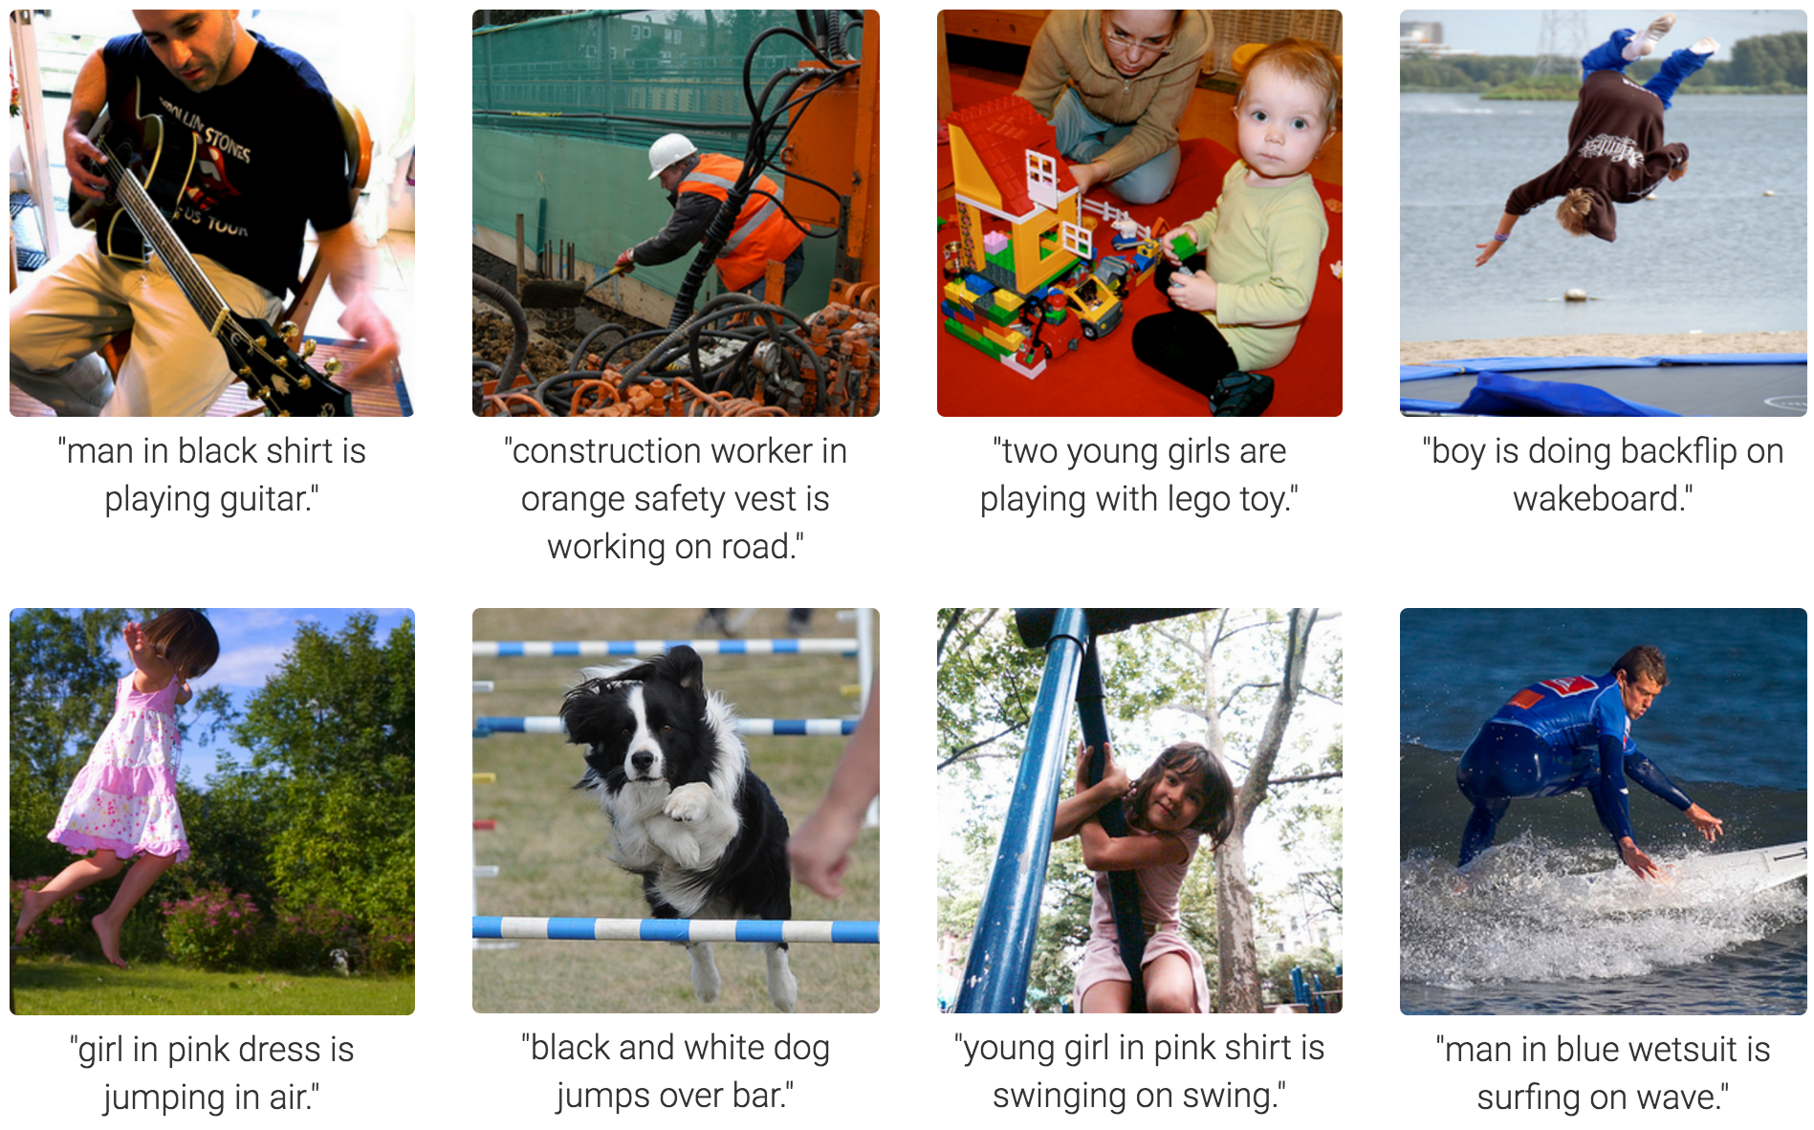
Computer Vision
Karpathy & Fei-Fei, 2015; Donahue et al., 2015; Xu et al, 2015; many more
Notes:
Very Impressive:
Form of prediction and deicion.

Slide 18
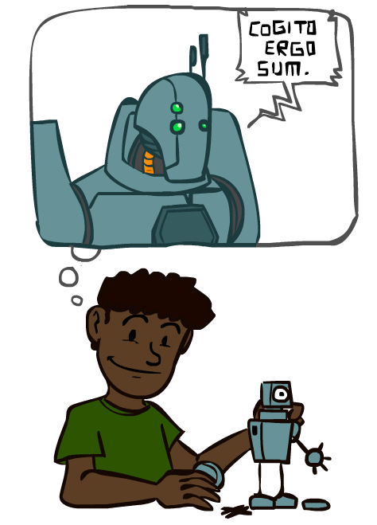
A (Short) History of AI
1940-1950: Early days
1943: McCulloch & Pitts: Boolean circuit model of brain
1950: Turing's “Computing Machinery and Intelligence”
1950—70: Excitement: Look, Ma, no hands!
1950s: Early AI programs, including Samuel's checkers program, Newell & Simon's Logic Theorist, Gelernter's Geometry Engine
1956: Dartmouth meeting: “Artificial Intelligence” adopted
1965: Robinson's complete algorithm for logical reasoning
1970—90: Knowledge-based approaches
1969—79: Early development of knowledge-based systems
1980—88: Expert systems industry booms
1988—93: Expert systems industry busts: “AI Winter”
1990—: Statistical approaches
Resurgence of probability, focus on uncertainty
General increase in technical depth
Agents and learning systems… “AI Spring”?
2000—: Where are we now?
Notes:
Computation with circuits, brain was like a bunch of circuits
Less computation than your watch; could barely do anything , but we thought we’re right there
Write stuff down, they start contradicting; winter
Statistics, uncertainty
Computation with artificial neurons, brain was like a bunch of real neurons ☺

Slide 20
Potential benefits and dangers of AI

Slide 21
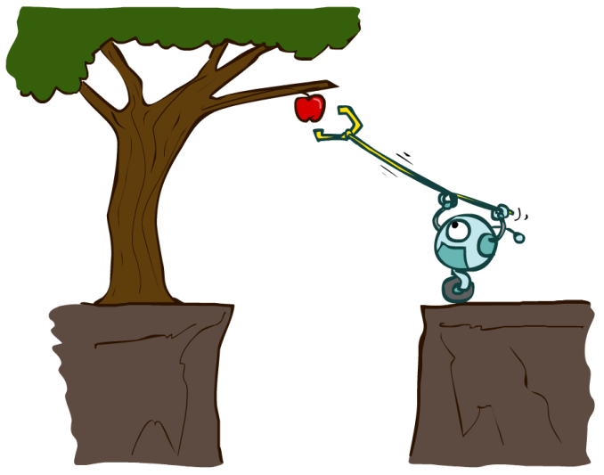
Designing Rational Agents
An agent is an entity that perceives and acts.
A rational agent selects actions that maximize its (expected) utility.
Characteristics of the percepts, environment, and action space dictate techniques for selecting rational actions
This course is about:
General AI techniques for a variety of problem types
Learning to recognize when and how a new problem can be solved with an existing technique
Sensors
Agent
Percepts
Environment
?
Actuators
Actions
Notes:
Agent perceives and acts – like you, like the automatic hallway lights,
What goes in this box?
Rational agent - also you, like your puppy, hopefully the ai creations in this class and my research.
Percepts, env, and action space determine problem
General AI techniques for a variety of problem types
Learning to recognize when and how a new problem can be solved with an existing technique

Slide 22
AI
Machine Learning
[learning decisions; sometimes independent]
Robots
[physically embodied]
Rational
Agents
[decisions]
Human-AI Interaction
NLP
Computer Vision
Notes:
Google maps route planning – not physically embodied
Independent decisions: typical ml prediction, e.g. spam filtering

Slide 23
Generative AI
Generative AI, also referred to as GenAI, allows users to input a variety of prompts to generate new content, such as text, images, videos, sounds, code, 3D designs, and other media. It “learns” and is trained on documents and artifacts that already exist online.

Slide 24
How does generative AI work?
Generative AI models use neural networks to identify patterns in existing data to generate new content. Trained on unsupervised and semi-supervised learning approaches, organizations can create foundation models from large, unlabeled data sets, essentially forming a base for AI systems to perform tasks [1].
Some examples of foundation models include LLMs, GANs, VAEs, and Multimodal, which power tools like ChatGPT, DALL-E, and more. ChatGPT draws data from GPT-3 and enables users to generate a story based on a prompt. Another foundation model Stable Diffusion enables users to generate realistic images based on text input [2].

Slide 25
Popular AI generators
There are several generative AI platforms you can become familiar with. You may find them helpful for automating certain processes in your workflow.
ChatGPT: This language model has a foundation of GPT architecture that generates text that resembles something a human would produce. It's a helpful companion for research, strategy, and content creation.
DALL-E2: This model generates images from text prompts, so creatives can create vibrant illustrations and concept art that’s a useful accompaniment to content marketing.
GitHub Copilot: This collaboration between GitHub and OpenAI acts as a coding companion to help developers code faster and more intuitively.

Slide 26
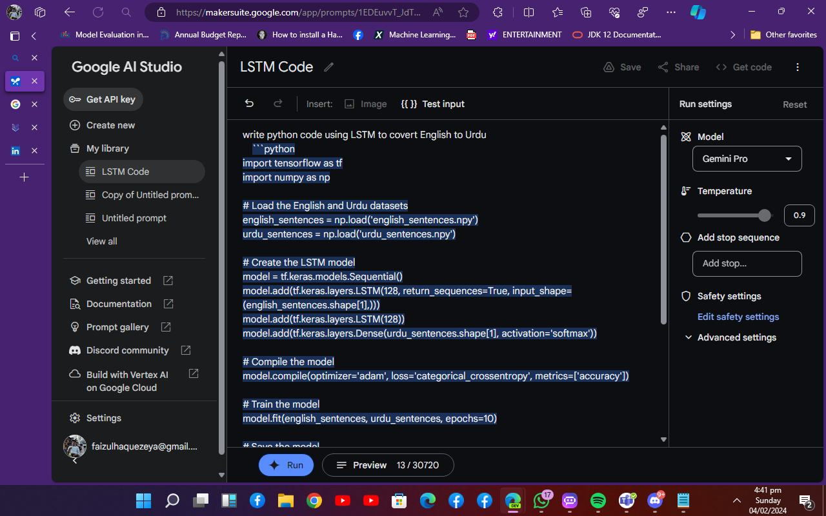
Google Vextex AI and Duet AI

Slide 27
